Slide 1
Agenda Item 5(2)
Constituent Body Structures
Nineteenth World Meteorological Congress
Geneva, 22 May – 3 June 2023

Slide 2
Reforming the constituent bodies…
… a journey from 1951 to 2019

Slide 3
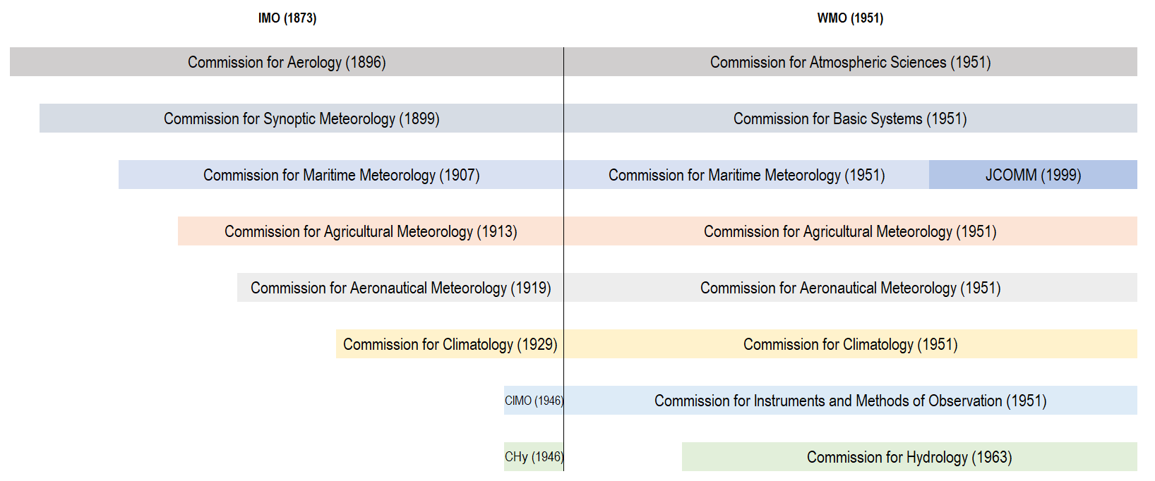
Technical commissions: a century-long continuity
Key structural changes: Commission for Bibliography and Publications terminated in 1963; Commission for Hydrology established in 1963; Commission for Marine Meteorology subsumed in the Joint WMO-IOC Technical Commission for Oceanography and Marine Meteorology in 1999
 | 3

Slide 4
Many reviews and a repeated proposal:
3(+1) commissions
Cg-I (1951) Canadian proposal | Cg-VI (1971) EC Panel of Experts on the Structure and Functioning of WMO (option 3) | Cg-IX (1983) EC Panel of Experts for the Review of the Scientific and Technical Structure of WMO (option (g)) | Cg-XIV (2003) EC Task Team on (Reviewing) the WMO Structure | Cg-18 (2019) EC Working Group on Strategic and Operating Planning
Commission for Synoptic Meteorology | Commission on Meteorological Operations | Commission for Basic Systems | CBS + CIMO | Infrastructure Commission
Commission for Applied Meteorology | Commission on Meteorological Services | Commission for Applications | Public Weather Services + CAeM + CAgM + CMM + application parts of CCL | Services Commission
Commission for Atmospheric Physics | Commission on Atmospheric Sciences | Commission for Research (and training) | CAS + scientific parts of CCl | Research Board (non-intergovernmental)
 | Commission on Hydrometeorology | Commission for Hydrology | Commission for Hydrology
 | 4

Slide 5
The 2019 governance reform: a watershed event
… within a continuous process of improvement

Slide 6
Questions requiring continued attention
Incorporation of Members’ priorities in planning processes
Prior assessment of risk and impact of new standards for Members
Participation of all Members in technical bodies and activities
Distinct and complementary roles of the different bodies
Keep the consistency of the regulatory and procedural framework
A key point: coordination of the scientific and technical programme (including the work programmes of technical commissions and regional associations)
Executive Council’s coordinating and management role:
a. planning, programme design and budget
b. scientific and technical coordination, implementation and monitoring
c. legal, regulatory and procedural matters
 | 6

Slide 7
The system of bodies dealing with technical and scientific matters
Responsibilities and interplays

Slide 8
Constituent bodies and additional bodies: programme matters
C4(a)(1) Congress
C14(b) 23(a) FR7(3) Approval of programme and budget
C8(d) Approval of Technical Regulations
GR154(2) Approval of scientific and technical programmes
C Convention
GR General Regulations
FR Financial Regulations
C8(h) Financial Advisory Committee
Advice on financial matters and the affordability, sustainability and implementation of the results-based budget
C4(a)(2) Executive Council
Including through subsidiary bodies
14 Coordination of programmes
C14(b) Recommendations on draft programme and budget
FR7(3) Biennial budget and appropriations for the approved programme
C14(c) Consideration of and action on resolutions and recommendations of regional associations and technical commissions
C14(f) Guidance on the work programmes of regional associations and technical commissions
C4(a)(4) Technical Commissions
C19 Study and make recommendations
GR III Implementation and
evaluation of technical and scientific programmes
C4(a)(3) Regional Associations
GR II Coordination and organization of Members’ activities
Requirements and impediments of Members with regard to programme and activities
C8(h) Research Board
Research priorities and coordination of research programmes
C8(h) Additional bodies
Scientific Advisory Panel: independent scientific advice
Joint WMO-IOC Collaborative Board: coordination with partner organization
WMO-UNEP Intergovernmental Panel on Climate Change: assessing the science related to climate change
C4(a)(5) Secretariat
C14(b) Draft programme and budget
GR 154(2) Daily programme management under the guidance of the Executive Council and in close collaboration with the technical commissions
Internal Oversight Office
FR13.7 Independent verification of […] operational activities, including programme evaluation, monitoring mechanisms […]
 | 8

Slide 9
Confirming the existing constituent bodies and additional bodies
Draft Resolution 5(2)/1 (Cg-19)
WMO technical commissions and additional bodies for the nineteenth financial period
THE WORLD METEOROLOGICAL CONGRESS,
Decides:
To continue the two technical commissions established by the Eighteenth Congress, with amended terms of references: (a) INFCOM and (b) SERCOM
To continue the additional bodies established or endorsed by Congress: (a) Research Board, with amended terms of reference; (b) Scientific Advisory Panel; (c) Joint WMO-IOC Collaborative Board; (d) Financial Advisory Committee, with amended terms of reference; and (e) Intergovernmental Panel on Climate Change
The regional associations play an irreplaceable role in the identification of the requirements and impediments of their Members about the programme and the technical and scientific activities of the Organization
The technical commissions and additional bodies are supplemented by the committees and panels set up by the Executive Council
 | 9

Slide 10
The role of the Executive Council
Coordination of the scientific and technical programme

Slide 11
EC: the executive body of the Organization with a complementary role on scientific and technical matters, and regional aspects
 | FP-1 1952-55 | FP-2 1956-59 | FP-3 1960-63 | FP-4 1964-67 | FP-5 1968-71 | FP-6 1972-75 | FP-7 1976-79 | FP-8 1980-83 | FP-9 1984-87 | FP-10 1988-91 | FP-11 1992-95 | FP-12 1996-99 | FP-13 2000-03 | FP-14 2004-07 | FP-15 2008-11 | FP-16 2012-15 | FP-17 2016-19 | FP-18 2020-23 | Cg-19 EC-77
Programme, technical matters and budget | AC-Programme |  |  |  |  | Committees on programme and budget |  |  |  | WG-LTP⁽²⁾ |  |  |  |  | WG-SOP⁽¹⁾ |  |  | PAC⁽¹⁾ | PAC
 |  |  |  |  |  |  |  |  |  |  |  |  |  |  |  |  |  | TCC⁽¹⁾ | TCC
Finance and administration | AC-Admin. and fin. |  |  |  |  |  |  |  |  | FINAC⁽¹⁾ |  |  |  |  |  |  |  |  | FINAC
Legal matters, reviews and reforms | WG(s)-Revision of the Convention⁽¹⁾, Gen.Regs and ToRs of TCs |  |  |  | PoE-Structure of WMO |  |  | PoE-Review Structure of WMO |  |  |  | TT-Review WMO structure |  |  |  |  | TF-CBR | TF-CRRCA | TF- CRRCA
 |  |  |  |  |  |  |  |  |  |  |  |  | TT-Changes to WMO Convention
 |  |  |  |  |  |  |  |  |  |  |  |  |  |  |  |  |  | TF-RE
Oversight |  |  |  |  |  |  |  |  |  |  |  |  |  | AOC⁽²⁾ |  |  |  |  | AOC
Capacity development | AC-TA⁽¹⁾ |  |  |  |  | C-TCQ |  |  |  |  |  |  |  |  | WG-CD⁽¹⁾ |  | PoE-CD | CDP | CDP
Capacity development |  |  |  | PoE-ETR⁽⁷⁾
Cryosphere |  |  | WG-AM⁽⁴⁾ |  |  |  |  |  |  |  |  |  |  |  | P(H)ORS |  |  |  | PHORS
Hydrology |  |  |  | CHy
Hydrology |  | PoE-WRD |  |  | AC-OH |  |  |  |  |  |  |  |  |  |  |  |  | HCP | HCP
Oceans |  |  |  |  |  |  | JWC-IGOSS |  |  |  | JCOMM |  |  |  |  |  |  | JCB | JCB
 |  |  |  |  | P-MO⁽³⁾
Climate | CCl
Climate | WG-IGY^{(4),} PoE-AZP, WG-MCD, P-HT, P-TM⁽²⁾ |  |  |  |  | PoE-CC⁽²⁾ |  | AC-WCAD |  |  |  |  | AG-CE |  | IBCS |  |  | CCP
 |  |  |  |  |  |  |  |  |  |  |  |  |  |  | WG-Climate |  | TF-CD
Disaster risk reduction and service delivery |  |  | WG-SSW |  |  |  |  |  |  | WG-EER |  |  |  |  |  | WG(s)-DRR and SD |  | SERCOM
Legend: AC Advisory Committee AOC Audit and Oversight Committee AZP Arid Zone Programme CC Climate Change CCl Commission for Climatology CCP Climate Coordination Panel CDP Capacity Development Panel CE Climate and the Environment CHy Commission for Hydrology C-TCQ Committee on Technical Cooperation Questions EER Environmental Emergency Response ETR Education and Training FINAC Financial Advisory Committee HCP Hydrological Coordination Panel IBCS Intergovernmental Board on Climate Services HT Humid Tropics IGOSS Integrated Global Ocean Services System IGY International Geophysical Year JCB Joint WMO-IOC Collaborative Board JCOMM Joint WMO-IOC Commission for Oceanography and Marine Meteorology JWG Joint Working Group MCD Marine Climatological Data OH Operational Hydrology PAC Policy Advisory Committee PHORS Panel on Polar and High-mountain Observations, Research and Services PoE-CD Panel of Experts on Capacity Development PoE-ET Panel of Experts on Education and Training SERCOM Services Commission SSW Seismic Sea Waves TA Technical Assistance TCC Technical Coordination Committee TF-CBR Task Force on the Constituent Body Reform TF-CRRCA Task Force on Comprehensive Review of the WMO Regional Concept and Approaches TF-RE Task Force on Reform Evaluation TM Tropical Meteorology TT Task Team WCAD World Climate Applications and Data Programme WG-AM Working Group on Antarctic Meteorology WG-DRR Working Group on Disaster Risk Reduction WG-LTP Working Group on Long-Term Planning WG-SD Working Group on Service Delivery WG-SOP Working Group on Strategic and Operational Planning WRD Water Resources Development In red, intergovernmental bodies

Slide 12
Achieving further efficiencies in the interactions among bodies
Draft Resolution 5(2)/1 (Cg-19)
WMO technical commissions and additional bodies for the nineteenth financial period
THE WORLD METEOROLOGICAL CONGRESS,
Requests:
The Executive Council:
(a) To continue reviewing the respective authorities and coordinating the relations among the constituent bodies, the additional bodies and their subsidiaries bodies, as well as the Secretariat, with regard to existing processes and mechanisms related to the technical and scientific programme of the Organization, including the identification and programmatic inclusion of Members’ needs and requirements;
(b) To submit proposals for the twentieth financial period to Congress based on the next Strategic Plan and an external evaluation of the effectiveness and efficiency of WMO bodies;
 | 12

Slide 13
Thank you
^{wmo.int}

